Slide 1
Annual Report on the IA for Co-operation on Tokamak Programmes
Tony Donné / Duarte Borba EUROfusion
Chair / Secretary,
Executive Committee February 15, 2019

Slide 2
Outline
Objective and scope of the CTP-TCP
Chair’s report
Governance
Membership
Outreach
Highlights and milestones achieved
Future plans

Slide 3
Objective and scope of the CTP-TCP
Advance fusion science and technology by strengthening cooperation amongst tokamak programmes.
Promote exchanges related to the experimental programmes of the partner tokamak facilities
Design and planning of experiments to contribute to the database for next generation tokamak devices
support of activities identified by the International Tokamak Physics Activity (ITPA) operating under the auspices of the ITER Organization since 2009

Slide 4
Governance
Tony Donné (EU) is Chair of the Executive Committee from 1 March 2017 to 29 February 2020.
China will soon appoint a Deputy Chair, who will take over as Chair from 1 March 2020 onwards for a 3-year mandate.
The 9th ExCo Meeting was held 17 January 2019 at ITER Headquarters.

Slide 5
Membership
CTP TCP has 8 Contracting Parties (CPs)
4 IEA member countries:
Australian Nuclear Science and Technology Organisation (ANSTO), Australia
National Institutes for Quantum and Radiological Science and Technology (QST), Japan
Korean Ministry of Education, Science and Technology (MEST), Korea.
United States Department of Energy (USDOE), United States
1 partner country:
The Institute for Plasma Research (IPR), India.
3 International Organizations:
European Atomic Energy Community (Euratom), European Union
ITER China Domestic Agency (CNDA)
ITER Organization

Slide 6
Membership
Australia has officially joined the CTP TCP in the course of 2018.
CTP recognises the importance of Russia as a major partner in the ongoing collaborations. The Chair has sent a new letter of invitation to ROSATOM to join the CTP TCP, but this was never answered. Informally the Russian ITPA representatives mentioned that the invitation should be send to the Russian Ministry of Energy, even though they don’t have links to fusion research.
Some interaction has taken place with Thailand which expressed the desire to become member, but after first e-mail exchanges not much has happened

Slide 7
Outreach
Main events during 2018-19
Princeton Plasma Physics Laboratory (PPPL) Workshop on Theory and Simulation of Disruptions (16-18 July 2018);
9th International Tokamak Physics Activities (ITPA) Joint Experiments Workshop (JEX) & 20th Meeting of the International Tokamak Physics Association (ITPA) Coordinating Committee & CTP-ITPA JEX Planning Meeting (15-17 January 2019);
KSTAR Conference (21-23 February 2019).
The website http://ctp.jet.efda.org/tcp/ has been significantly upgraded, modernised and information revisited.

Slide 8
Personnel Assignments
Overviews of the most frequent assignments

Slide 9
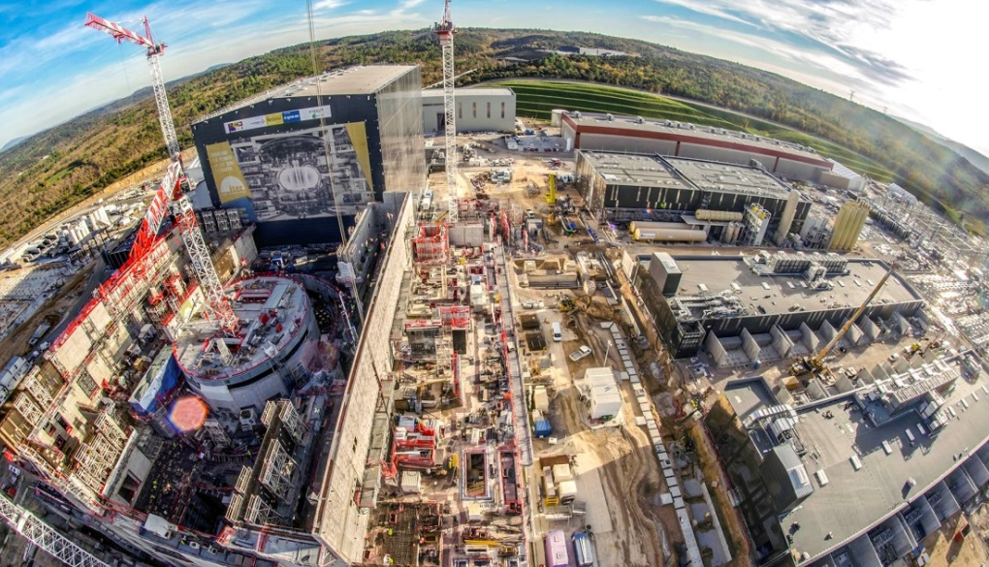
Key achievements related to new facilities
ITER 60% of completion to First Plasma; with First Plasma in expected in 2025
JT60-SA: 92% of the Broader Approach Phase I has been completed; First Plasma in 2020 as scheduled
ITER
JT60-SA

Slide 10
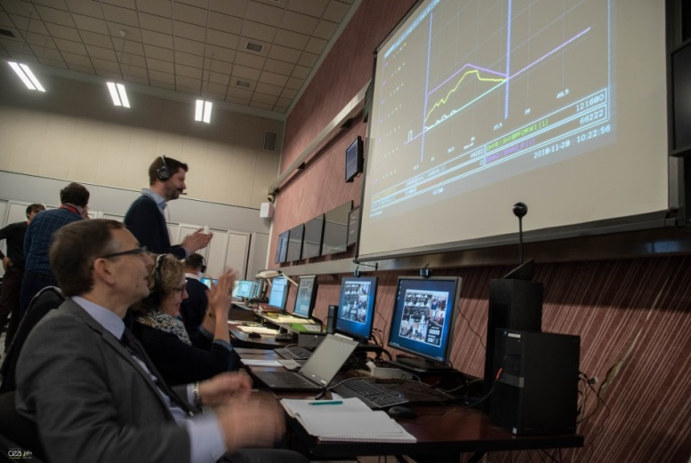
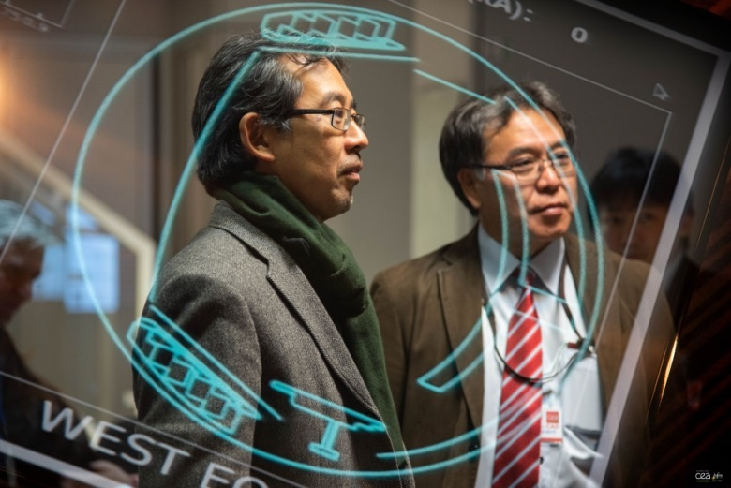
Key achievements related to new facilities
WEST tokamak controlled from Japan

Slide 11
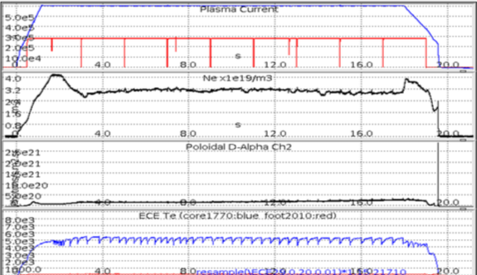
Key physics achievements
Longest Internal Transport Barrier achieved in 2018 in KSTAR (~20s).
Plasma Current
Plasma Density
Plasma Temperature

Slide 12
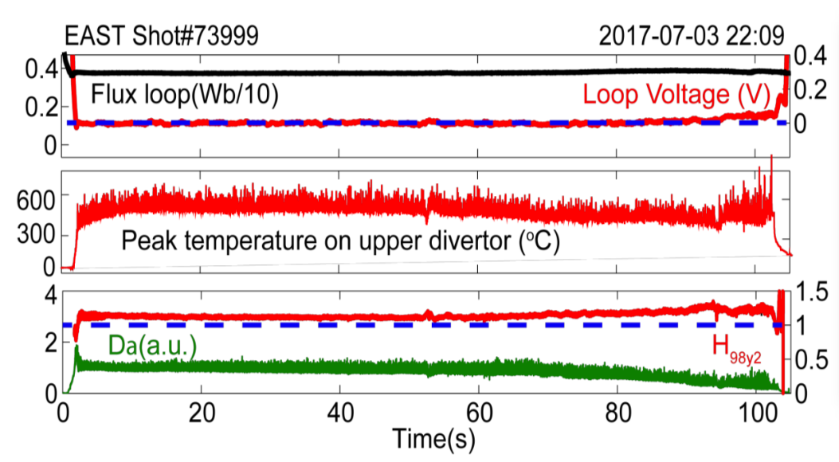
Key physics achievements
EAST long pulse steady-state H-mode operation with upper tungsten divertor (100s) with integrated plasma control, saturated surface temperature, good confinement and small ELMs.

Slide 13
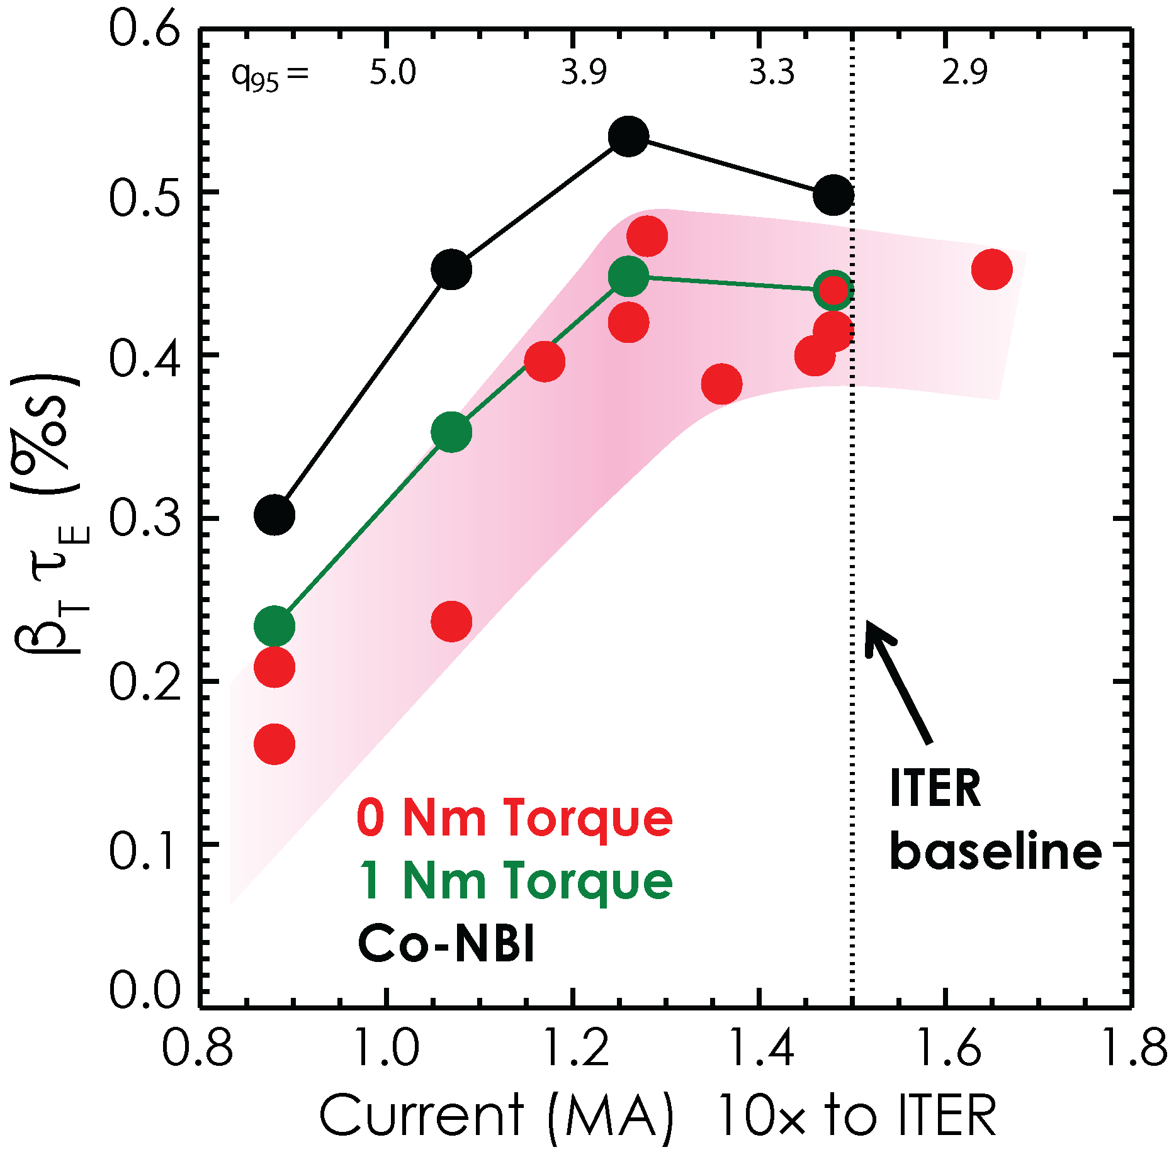
Key physics achievements
In DIII-D Stable zero-torque operation obtained by modify initial current profile, slowing current ramp and delaying H-mode transition, but fusion gain (β_{T}τ_{E}) doesn’t improve below q₉₅=3.7

Slide 14
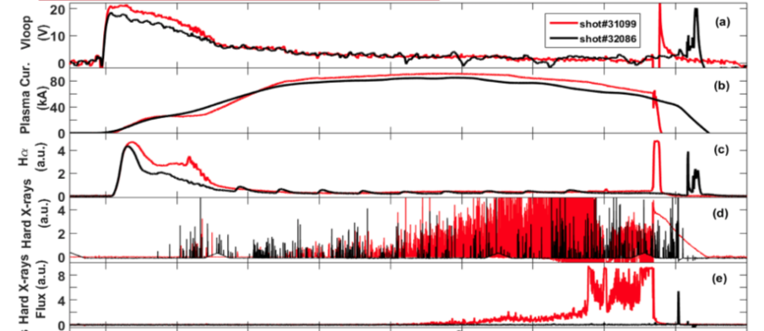
Key physics achievements
ADITYA was dismantled in 2015 and reassembled as an upgrade ADITYA-U in 2016. Features include a new circular vacuum vessel, possibility of open divertor operations, and an experimental focus on disruptions, runaways and other MHD studies.
Operational control over runaway electron content in ADITYA-U lead to discharges with runaways (RED) and without runaways (BLACK) as shown below:
Loop Voltage
Plasma Current
H-alpha Light
Hard X-rays emission

Slide 15
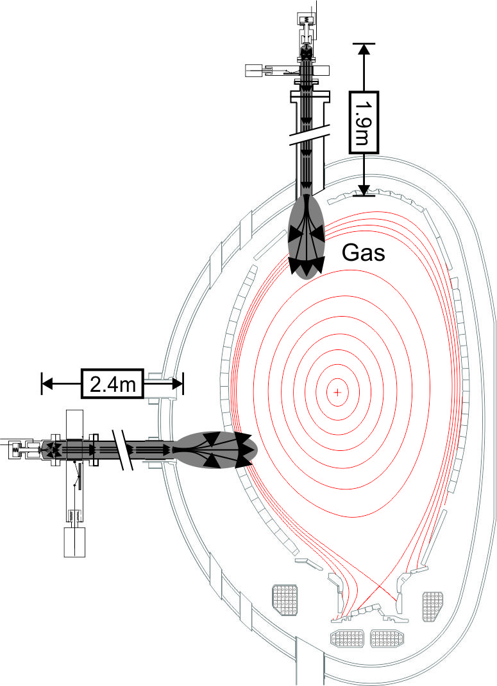
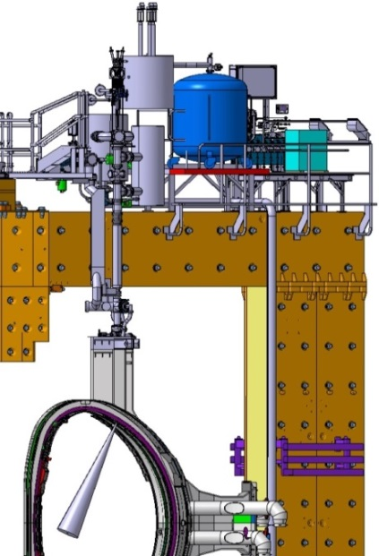
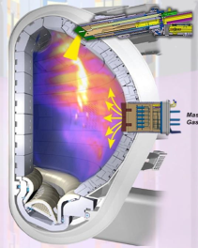
Future plans
Mitigation of disruptions a critical issue for ITER
Framework agreement between 4 CTP partners to design, construct, install and operate ITER relevant hardware on JET
Test the concept of Shattered Pellet Injection (SPI) for mitigation of runaway electrons during disruption current quench
Commissioning with plasma and experimental campaign in 2019

Slide 16
Additional Slides

